Slide 1
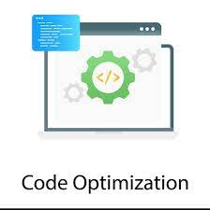
Code Optimization using Machine Learning
S. NITHIN KUMAR (192211234)
C. KUSHWANTHU (192211304)
P.V. MANOJ SAI (192224167)

Slide 2
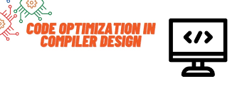
ABSTRACT:
The goal of this study is to improve programme performance and efficiency by examining the incorporation of machine learning (ML) approaches into code optimisation.
It divides ML techniques into four categories: supervised, unsupervised, reinforcement, and deep learning techniques, and then talks about how to use them in different optimisation problems.
The paper presents case studies and techniques that illustrate the usefulness of machine learning (ML) in performance tuning, runtime enhancement, and compiler optimisation.
In conclusion, it highlights how machine learning (ML) can simplify optimisation tasks, freeing up developers to work on more creative and innovative projects, and it makes recommendations for future research directions.

Slide 3
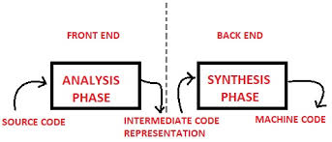
Introduction:
This introduction unlocks the synergy between machine learning and code optimization and shows how data-driven approaches improve software development.
Automated refactoring and performance profiling are only two examples of the optimization chores that machine learning algorithms may automate by analyzing code and performance data.
In the intersection of machine learning and code optimization, this introduction shows how data-driven approaches improve software development.
This combination promises to change development and open the door for effective, efficient software engineering, despite obstacles like data quality.

Slide 4
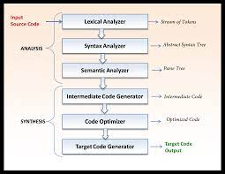
Problem Statement:
One of the main challenges in the field of machine learning-based code optimization is the successful integration of these cutting-edge methods into software development procedures that currently exist.
Although code efficiency can be increased and optimization chores can be automated with machine learning, adoption may be impeded by the technology's inability to integrate smoothly with current development methods.
In order to ensure compatibility, usability, and efficacy, this issue statement emphasizes the necessity for strong processes and tools that smoothly incorporate machine learning-based code optimization approaches into developers' workflows.

Slide 5
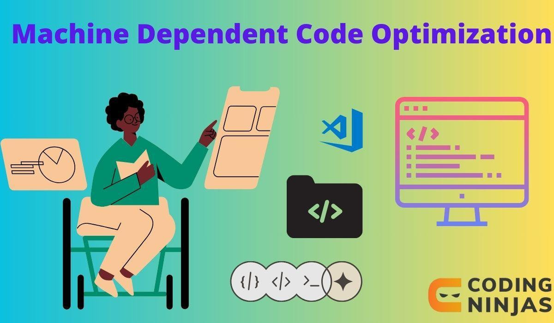
Functionality:
Code profiling: It is the process of automatically examining code to find areas for improvement and performance bottlenecks, such as resourceintensive processes or wasteful loops.
Predictive analysis: Developers can proactively solve performance issues before to deployment by anticipating them through the analysis of previous data and patterns.
UI DESIGN:
Give users access to a text editor or code input area so they may type or paste code.
To evaluate and improve the code, apply machine learning models. Provide recommendations for display optimization, speed enhancements, or code reworking.

Slide 6
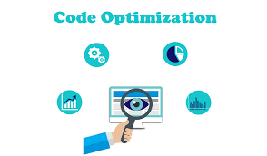
Elements positioning and functionality:
The code editor is prominently located in the middle of the user interface.
Features: Enables users to upload or enter their code. supports basic code editing features and syntax highlighting.
Machine Learning Engine: • The user cannot immediately see backend integration.
Functionality: Provides optimization recommendations after analyzing user-inputted code.

Slide 7
CONCLUSION:
To sum up, creating a smooth and easy-to-use user interface for code optimization through machine learning requires combining a number of different components.
Developers can analyze and optimize their code more effectively by combining a code editor, machine learning engine, suggestion panel, visualization tools, interactive feedback mechanisms, version control integration, performance metrics dashboard, integration with development environments, user assistance features, and community collaboration features.

Slide 8


